Slide 1
Feature Extraction for Multi-Layer Graph Link Prediction
Dimitris Vogiatzidakis

Slide 2
Flink-Mancer
Flink-mancer is an attempt to replicate the work of TwitterMancer using parallel computation.
We used the Apache Flink Framework to achieve this.

Slide 3
TwitterMancer
Twitter Mancer tries to answer the following question:
Given two Twitter users u; v, and the Twitter multilayer interactions, can we predict what type of interactions will take place between u; v?
The answer is yes.
They achieved this by extracting Features out of datasets.
They used those features to train a logistic regression model.

Slide 4
TwitterMancer Features
Twitter Mancer used 4 layers
reply, follow, retweet, quote
They extracted 100 features in total.
10 directed degree features:
4 outdegree of u (1 for each layer)
4 indegree of v
1 for Number of different interactions u initiated
1 for Number of different interactions v received

Slide 5
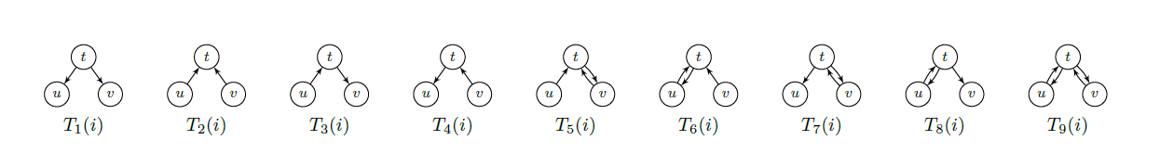
TwitterMancer Features
36 features considering a common neighbor t
9 for each possible way t interacted with both u and v
Multiplied by 4 for each layer 9x4= 36

Slide 6
TwitterMancer Features
54 similar features involving the interplay between pairs of interactions
9 for each possible way t interacted with both u and v
Multiplied by 6 ( n(n-1)/2 , n=layers) 9x6=54

Slide 7
Flink-Mancer Design
2
1
3
4
We created 2 adjacent lists for every layer, one for incoming neighbors and one for outgoing.
We used outer join to combine them and have an ‘empty’ slot for every missing link.
For example Node1 has incoming [2,3] and outgoing [3,4]
By using outer joing we have a result of {[2,3,[]],[[],3,4]} instead of {[2,3],[3,4]}.

Slide 8
Flink-Mancer Design
We used the same technique for every Dataset created on previous step and combined them in a final Tuple8.
The final result was a Dataset of Tuple2<id,Tuple8<>>
We transformed those into “Nodes”. Node is a POJO with 2 variables, an ID and a List of Sets.
We created a cross product of those Nodes with themselves. This creates every possible edge given our known ids.
Our final DataSet consists of Tuple2<Node,Node>.

Slide 9
Flink-Mancer Design
We apply function Feat() to every Edge in our Dataset which extracts all the features needed.
The result is a Dataset which contains every possible edge, and 100 features for every one of them.

Slide 10
Flink-Mancer Design
Reason to go with the specific design:
The final Dataset before the feature extraction contains the Id of the Node, and a List of Sets for all of its neighbors.
Set intersection is a very fast computation.
Extracting features out of a U – V edge, becomes really simple and fast when every Node knows its neighbors.

Slide 11
Flink-Mancer Scalability
When it comes to DRAM and Cores, Flink allows us to use as many as we have.
This means that the system can scale as long as we add new machines to the cluster.
Parallel Computing with Flink allows us to process larger data that were previously not possible because of time or Dram limitation.
Flink-mancer is currently -hardcoded- to 4 layers but with a few simple steps you can increase the number of layers it can receive as input.

Slide 12
Flink-Mancer Limitations
Currently Flink does not support a ML library.
That means we cannot fully replicate the TwitterMancer using flink.
Our current state , produces a csv with all the features
Since we are creating a crossproduct we have a n*n*102*4 bytes filesize and the hard drives run out of space.
One solution is to use Kafka to redirect the features to Spark to train a logistic regression Model.

Slide 13
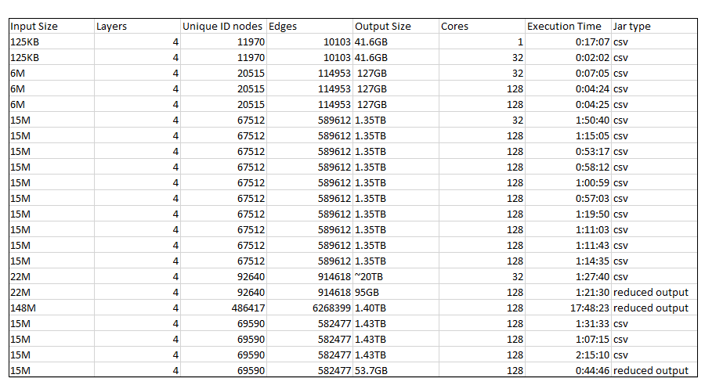
Flink-Mancer Results (incomplete)

